Slide 1
Software Design -
Foundational Concepts
Phil Pfeiffer
January 2015

Slide 2
Overview
Purpose
Rationale
Definition
Key Attributes
Methodologies
  Examples
  Commonalities among methodologies
Evaluation
Closing Perspective

Slide 3

"Design is Getting from Here to There"
Henry Petroski
▪ Professor, Duke University
▪ Author, To Engineer is Human
Here
▪ Deliverable's description (requirements)
There
▪ Deliverable's realization (implementation)

Slide 4
Design: a Definition
A detailed characterization of an artifact
– any artifact –
that's
▪ accurate, in that it captures what's wanted;
▪ clear, in that qualified practitioners can understand it;
▪ precise, in that it's sufficient for implementation;
▪ general, in that it allows flexibility in choice of implementations, where feasible
Often likened to a blueprint
Definition based very loosely on Eric Braude, Software Design: from Programming to Architecture

Slide 5

Why Design? Three Authorities
Joel Spolsky
▪ CEO of Fog Creek Software
▪ long-time blogger on software development
(cf. www.joelonsoftware.com)
▪ Author: Joel on Software
Issue: "Code-first" wasteful
▪ A must when exploring new ground;
however,
▪ More often, a "weird" form of laziness
▪ Excuse to avoid thinking before coding
▪ Ultimately, results in more work

Slide 6
Spolsky on Code-First and XP
Effect of XP on contemporary practice
▪ XP says: "Don't do any more design than needed"
▪ People hear: "It's OK not to design things before implementing them".
We use high-level tools these days, just like Java and XML.
We can change things in minutes in the code.
Why not design it in code?
Spolsky: this simply isn't true.
▪ Nothing is as simple as it seems.
▪ Code can't be changed "as easily" as design documents.
▪ Bad decisions and their costs hurt businesses.
http://www.joelonsoftware.com/articles/NothingIsSimple.html

Slide 7

Why Design? Three Authorities
▪ Barry Boehm
▪ USC Professor
▪ ACM / IEEE Fellow
▪ Spiral Model of Software Development
▪ COCOMO Model of Software Effort
▪ Issue: cost of errors
▪ Rework during coding up to 10x more costly than rework during design

Slide 8

Why Design? Three Authorities
Robert Glass
▪ President, Computing Trends
▪ Editor-in-chief,
Journal of Systems and Software
▪ Author, 20 books
▪ Pioneered analysis of failed software projects
▪ Columnist, CACM, IEEE Software
Issue: avoid oversimplification

Slide 9
Glass: Study of Erroneous Programs
170+ errors classified by type
1. Omitted logic 60
2. Failure to reset data 23
3. Regression error 17
[correcting one error produces another]
4. Erroneous documentation 17
5. Inadequate requirements 11
6. Buggy patch 11
7. Erroneous comment 11
8. "If" statement too simple 10
9. Reference to the wrong variable 10
Design errors a major source of errors (1, 2, 3, 6, 8)
Most errors were due to designs that were too simple,
rather than too complex
Robert Glass, Software Soliloquies, pp. 54-63

Slide 10
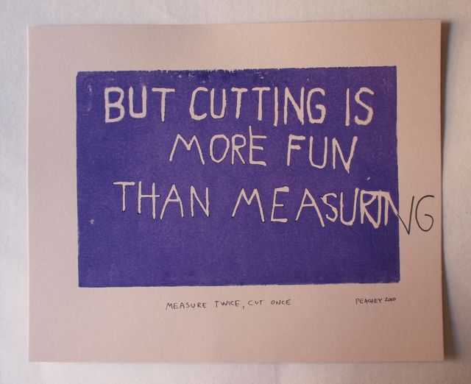
Synopsis of Arguments
"Measure twice, cut once"
Computing version, #1:
The first strategy you think of to solve a problem is usually pretty bad. The next is mediocre. The third starts to be good.
-- Prof. Raphael Finkel, U. Ky.
Computing version, 2:
Don’t waste your time: study before you program. The alternative: code in haste,
debug forever.
http://www.cmu.edu/acadev/fastfact/Succeed%20in%20CS08.pdf

Slide 11
Key Attributes of "Good" Designs
Accuracy
▪ Correctness: i.e., consistency with requirements
▪ Completeness: i.e., full coverage of requirements
Clarity
▪ Can be grasped without "undue effort"
Precision
▪ Unambiguous; can be implemented with no add'l advice
Generality
▪ Independent, where possible, of specific languages, platforms

Slide 12

More Key Attributes for Software Designs
Feasibility and Flexibility
▪ Corollary of a favorite definition of software development: i.e.,
A cooperative game with two goals:
▪ delivering a working object
▪ preparing for further updates
Author: Alistair Cockburn
▪ Inventor of Use-Cases
▪ Signatory of Agile Manifesto
▪ Developer of Crystal
▪ Dana Campbell look-alike
http://alistair.cockburn.us/Software+development+as+a+cooperative+game

Slide 13
Other Design Concerns
Importance varies by user, business requirements:
▪ Speed: e.g., high-performance computing
▪ Timeliness: e.g., real-time systems
▪ Robustness: e.g., safety-critical systems
▪ Feature-
completeness: e.g., systems for power users
▪ Fast
implementation: e.g., products in competitive markets
▪ Low cost: e.g., bulk purchasers
▪ User friendliness: e.g., novices, users w. short memories

Slide 14
How Design is Done: Methodologies
Methodology = way of working
Big-M vs. small-M methodologies (Cockburn)
▪ Big-M: encompass entire process
▪ process-centered
▪ data-centered
▪ object-centered
▪ component-based
▪ declarative / rule-based
▪ Small-M: encompass aspect(s) of process

Slide 15
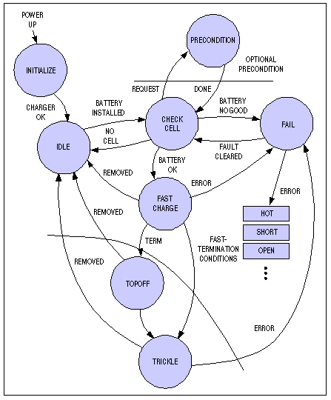
Process-Centered
Big-M
Methodologies
State-based design
▪ Identify program's states
▪ Construct control flow
around states,
inter-state transitions
http://www.jcelectronica.com/articles/state_machines.htm

Slide 16
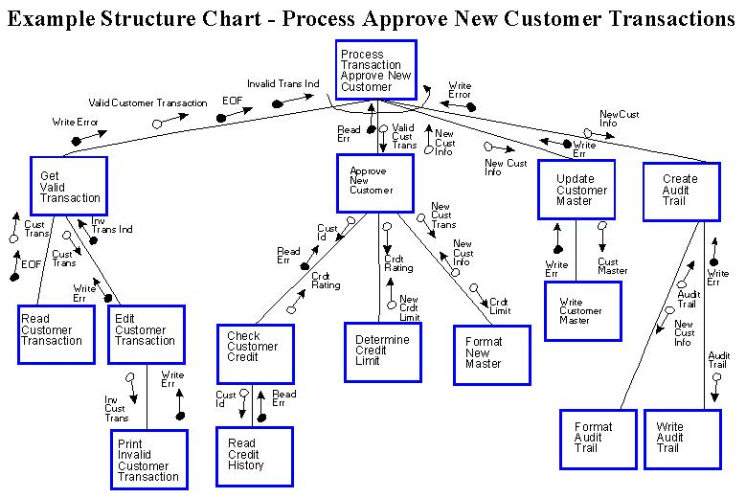
Process-Centered Big-M Methodologies
Structured Design
▪ identify key processes
▪ cast as hierarchy
http://farm1.static.flickr.com/222/488324744_faa49b8ba3_o.jpg

Slide 17
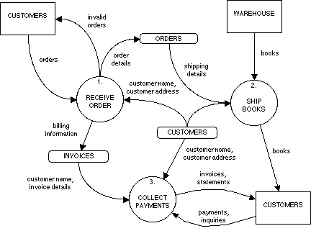
Data-Centered Big-M Methodologies
Dataflow
Analysis
a.k.a.
Structured
Analysis
▪ Depict dynamic
flow of data
through system
▪ Bubbles become
application's
structural elements
http://www.cs.pitt.edu/~chang/153/images/dfd01.gif

Slide 18
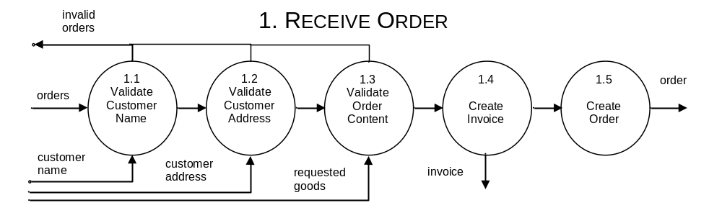
Data-Centered Big-M Methodologies
Dataflow Analysis (cont.)
▪ Top-level bubbles expanded into more detailed transformations
▪ Each bubble should correspond to one cohesive transformation
▪ General process: validate input; transform to output
▪ Bubbles map to functions
▪ Break between validating input, transforming output corresponds to main

Slide 19
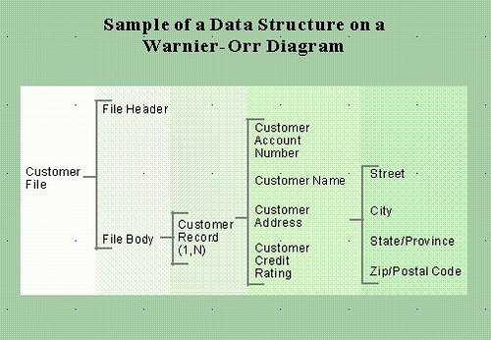
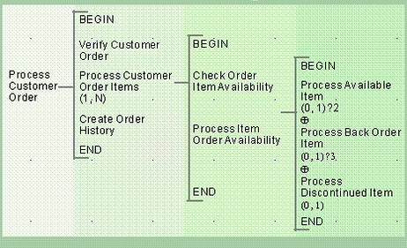
Data-Centered
Big-M Methodologies
Warnier-Orr, a.k.a.
Data Structured Systems Development
Identify logical output structure
Create Warn.-Orr data diagram(s)
Identify logical process structure
Create Warn.-Orr logic diagram(s)
▪ Includes operators for sequences, iteration, selection
http://it.toolbox.com/blogs/enterprise-solutions/using-warnierorr-diagrams-16595

Slide 20
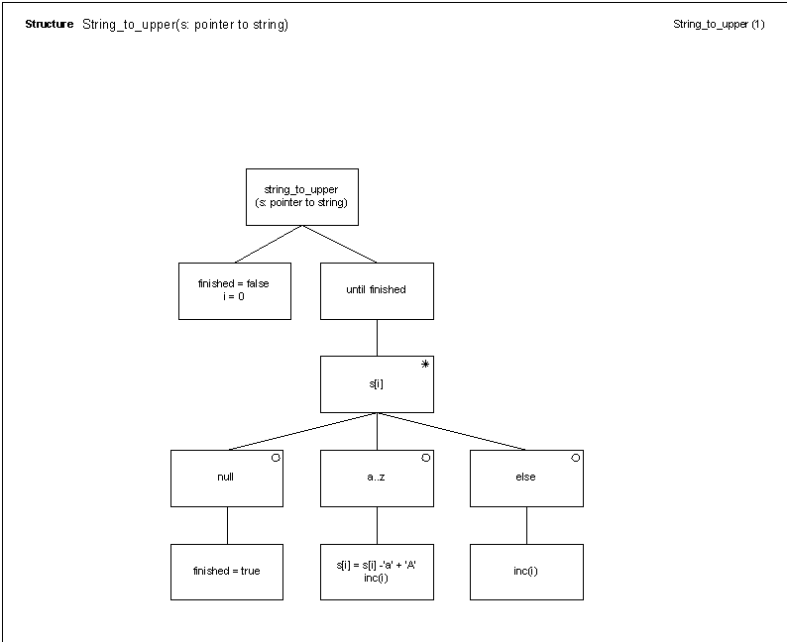
Data-Centered Big-M Methodologies
Jackson Structured Design
▪ Models input, output data as trees
▪ Identifies correspondences between input, output trees
▪ Coverts trees to structured
program model by defining functions to map elements of input tree to elements of output tree
▪ Expand into detailed model by
▪ listing operations
▪ defining data structures
▪ writing detailed pseudocode
http://www.lisisoft.com/tools/visio--software.html; see also
http://www.jacksonworkbench.co.uk/stevefergspages/papers/ourusoff--introduction_to_jackson_design_method.pdf

Slide 21
Object-Centered Big-M Methodologies
Key construct: object
▪ Definition: run-time entity with five properties
▪ An identity (i.e., a referent)
▪ A set of behaviors
▪ A lifetime
▪ An interface
▪ A state - i.e., ability to remember, be influenced by past interactions
▪ if you have a devil of a time remembering these, think "iblis"
(Arabic for "devil")
Reasons for objects' appeal
▪ "Natural" mapping from problem domains to software
▪ Objects as "metaphors" for domain elements
▪ Promote maintainability, reuse
▪ Combines data and process into single entity

Slide 22
Object-Centered Big-M: Object-Based Design
▪ Preceded object-oriented
(OO) software development
▪ Still important for languages
without explicit OO support:
e.g., C, Fortran, XSLT
▪ Strategy
▪ Identify key entities (objects)
in domain of concern
▪ For each entity
▪ Identify key attributes
▪ Define set of names
(unique IDs)
▪ Create table that pairs IDs with key attributes
▪ Identify key lifecycle operations
(create/ read/ update/ delete)
▪ Define operations as functions
that read, update attributes table
Example domain objects:
(rechargeable) battery,
charger, outlet, appliance
Example model of battery objects:
type serial_number: int;
struct battery_data{
battery_id: serial_number;
max_charge: positive_float;
current_charge: float;
still_operating: true;
}
serial_num = add_battery( );
status = is_operating( batt_ID );
charge = get_charge( batt_ID );
recharge( batt_ID, added_charge );
drain( batt_ID, lost_charge );
discard( batt_ID )

Slide 23
Object-Centered Big-M: Obj.-Oriented Design
▪ Like obj.-based design, but with language support for objects:
▪ encapsulation
(aggregating related logic and data in a single syntactic entity)
▪ information hiding
(limiting access to internal object state to object's logic)
▪ classes
(templates for creating
sets of related objects)
▪ inheritance
(defining one class in terms of
a second, related class)
▪ polymorphism
(defining one method in terms
of a second, related method)
▪ Yields cleaner, safer code
Battery: class {
public methods:
battery( );
recharge( added_charge );
drain( lost_charge );
charge get_charge( );
~battery( );
private data:
max_charge: positive_float;
current_charge: float;
is_operational: boolean;
};
Battery flashlight_battery;
flashlight_battery.drain( 0.4v );
…

Slide 24
Component-Based Big-M Methodologies
Objectives:
▪ development of software from sets of related objects
▪ reuse of parts across applications and contexts
▪ creation of easily maintainable and customizable parts
for new functions and features
One methodology (Vithrana et al.):
▪ analyze problem domain
▪ catalogue, then retrieve, available components
▪ design and develop missing components
▪ select components, then assemble applications
Sharp and Ryan, "A theoretical framework of component-based software development phases",
February 2010 SIGMIS Database , Volume 41 Issue 1

Slide 25
Declarative Big-M Methodologies
Expr ::= identifier
Expr ::= UnaryOp Expr
UnaryOp ::= +
UnaryOp ::= –
Expr ::= Expr BinaryOp Expr
BinaryOp ::= + | – | * | /
Expr ::= ( Expr )
( 4 + 3 ) * ( -7 )
*
+ –
4 3 7
Designer describes application's operation
with meta-language
Translator converts description to logic
Examples:
  Programming language compilers (grammars)
  Domain-specific languages (UML-based grammars)
http://www.math.grin.edu/~rebelsky/Courses/CS302/99S/Outlines/outline.27.html

Slide 26
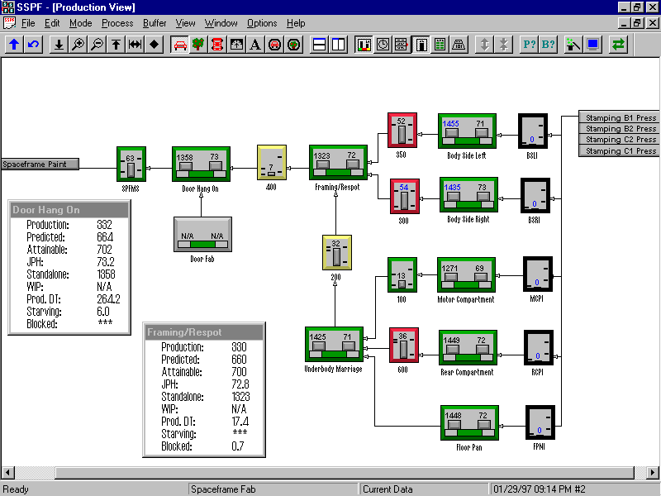
Image of a DSL for Auto Design

Slide 27
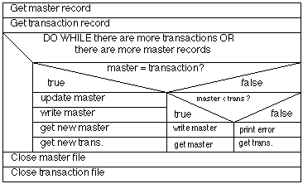
Selected Small-M Methodologies
Nassi-Shneiderman
diagrams (see image)
Test-driven design
▪ Define tests first
▪ Code to tests
Feature-driven design
▪ Define and prioritize features
▪ Incrementally add features
Classes-responsibilities-collaborations (CRC)
▪ Identify classes
▪ Identify and document their responsibilities
▪ Identify and document how they work together
http://yourdon.com/strucanalysis/wiki/index.php?title=Chapter_15

Slide 28
Causes of Methodological Proliferation
Computer languages have evolved
▪ Earlier methodologies reflected concerns of earlier eras: e.g.,
▪ Creating procedures (in languages without classes)
▪ Structuring logic (in languages with only do loops and goto's)
▪ Rise of OO in early 80's, due to increases in memory size, processor speed, created opportunities for new techniques
So has the profession
▪ Contemporary projects becoming more ambitious
▪ Rise of Internet and Service-Oriented Architectures
▪ Rise of commercial, off-the-shelf software (COTS) has created oportunities for new strategies for software development
▪ Component-based
▪ Declarative (UML a big factor)

Slide 29
Commonalities Among Methodologies
Use of partitioning and layering (or leveling)
to manage design
Use of stepwise refinement to develop complex artifacts
Use of graphics to clarify process, structure
Use of precepts for assuring quality of artifacts

Slide 30

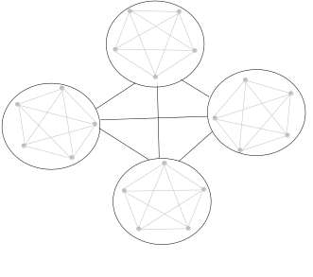
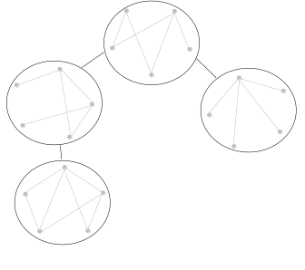
Partitioning and Layering
Improve manageability by circumscribing interactions amongst design's elements
Quality of partitioning crucial for clarity
▪ cohesion:
degree to which a design element corresponds to exactly one entire action or entity from problem domain
▪ separation of concerns:
degree to which one design element is insulated from changes to a second
▪ typically phrased negatively, as coupling
Layering - ordering dependencies among modules
▪ Important for testability as well as clarity

Slide 31
Stepwise Refinement
Standard for non-trivial design problems
▪ Graphic arts, Architecture, Writing, Filmmaking, …
Stepwise refinement in software design
▪ High-level (architecture)
▪ 7-10 element diagram of key components, plus
▪ Broad perspectives on system design
▪ Service level
▪ View of system as request-response-driven interactions
amongst high-level components (i.e., sets of related classes)
▪ For larger, distributed systems
▪ Middle-level
▪ Classes (i.e., collections of related functions, data structures)
▪ Low-level
▪ Individual functions, data structures

Slide 32
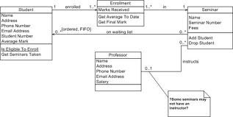
Graphic Representations
Where possible:
hierarchies
Where required:
labeled (hyper)graphs
agilemodeling.com

Slide 33
Cross-Metholodology Precepts
Accuracy
Correctness
▪ traceability checks
▪ reuse
▪ assertions
▪ preconditions
▪ invariants
▪ postconditions
Completeness
▪ traceability checks
Precision
▪ Explicit characterization of logic
▪ static and dynamic structure
▪ component behavior
▪ internal
▪ external
▪ deployment
▪ Explicit characterization of data
▪ structure, content of sources
▪ structure, content of sinks

Slide 34
Cross-Metholodology Precepts
Clarity
▪ Simplicity
▪ seeking cohesion
▪ seeking symmetry
▪ avoiding choice
▪ Uniformity
▪ interfaces
▪ reuse
▪ naming
Generality
▪ Sufficiently abstract characterization of process, data, rules
Feasibility
▪ Reuse
▪ Using structure to limit overall complexity
▪ partitioning
▪ layering
Flexibility
▪ Isolating instabilities in their own components
▪ requirements
▪ platform characteristics

Slide 35
Aside: Difficulties with Precepts
Literature has ample advice on design strategies
Problems with advice
▪ Can be too vague to follow: e.g.,
▪ "Use clear names" (what is a clear name?)
▪ Can be contradictory
▪ Martin Fowler's book on refactoring (i.e., revising) code for
clarity repeatedly includes transforms and their opposites: e.g.,
▪ Turn constant into variable vs. turn variable into constant
▪ Split function vs. combine functions
▪ Sites like www.c2.com/cgi/wiki (Cunningham & Cunningham), which air principles and their inverses: e.g.,
▪ YAGNI (you aren't gonna need it) vs. YAGNI (are gonna need it)

Slide 36

Design Advice: a Perspective
Bertrand Meyer
Creator of Eiffel - what C++
and Java should have been
Author of Object-Oriented
Software Construction - 1200+ pp.
Divides advice into two kinds
▪ Platitudes: vague to point of uselessness
▪ Principles: practical
Distinguishes four kinds of principles
▪ Absolute positives: "Always do x"
▪ Absolute negatives: "Never do x"
▪ Advisory positives: "Do x when possible"
▪ Advisory negatives: "Avoid x when possible"

Slide 37
Meyer on Design Principles
Criteria for absolute positives
▪ Favor absolute positives
▪ Consider automated enforcement, via tools or language constructs
Criteria for absolute negatives
▪ Back with precise rationale, along with explanation of how to substitute other mechanisms for it
Criteria for advisory rules
▪ Exceptions must be clearly defined in statement of rules
Giveaway phrases for platitudes
▪ … unless you know what you are doing
▪ … unless you absolutely have to
▪ Avoid … if you can
▪ Try not to …
▪ It is generally preferable not to …

Slide 38
Evaluation: Attributes in Isolation
Subjective application of principles useful for rough assessments of key attributes described here
Beyond this, evaluation mostly a research topic
▪ Accuracy
▪ Correctness impossible to verify for arbitrary programs,
due to halting problem
▪ Still impractical for many/ most programs
▪ Program proving, model checking active areas of research
▪ Clarity
▪ Some aspects characterized via qualitative characterization, complexity metrics
▪ Feasibility
▪ Effort estimation techniques (e.g., function points)

Slide 39

Evaluation: Overall Design
Weinburg: quality is relative
▪ Quality is value to some person.
▪ Every statement about quality
is a statement about some person(s).
▪ Quality is almost always a political / emotional issue, though we would like to
pretend it can be settled rationally.
▪ Quality is not identical with freedom from
errors.
▪ Quality is the ability to consistently
get what people need.
Focus this semester on traditional concerns:
▪ Accuracy, Clarity, Generality, Flexibility
Gerald Weinburg, Qualitative Software Management: Volume 1, Systems Thinking

Slide 40
Closing Perspective
Why design is difficult
▪ Tendency for combinations of requirements to interact,
creating complex problems
▪ Need to manage multiple dimensions of quality -
and to do so under time and budgetary constraints
▪ Inherent difficulty of expressing ideas simply and clearly
Why practitioners skip design
▪ Wishful thinking about project difficulty
▪ Key mistake: failing to account for extra complications created by interaction of "simple" requirements
▪ Caving to pressure to start coding to show progress
Short cuts oft make long delays.
-- J.R.R. Tolkien, Lord of the Rings

